Slide 1

Oral Progress Report
GENG5511
Nicholas Butterly
21714914
20/09/21

Slide 2

Agenda
Key Details & Background
Problem statement & research questions
Methodology
Timeline – Weekly Milestones
Current Progress & Upcoming Work
Challenges

Slide 3
Key Details
Purpose
Project: Advisian ‘NZE Roadmap’ Project
Framework: Adapted ACT Generic Methodology
ASX100 companies NZE targets:
42% have NZE targets, but…
Only 16% provided emissions reductions plans
Need for new tools to help decarbonisation projects
Developing decarbonisation tools for PM’s & companies

Slide 4

Problem Statement & Research Questions
What is the potential role of sector-based ‘decarbonisation assessment tools’ in helping companies navigate the impending low-carbon energy transition?
Q1: To what extent might the current decarbonisation performance of the Client be quantified using the ACTMM decarbonisation assessment tool?
Q2:
To what extent might the NZE Roadmap Project improve or alter the Client's decarbonisation score?

Slide 5
Methodology
P1: Creation of Assessment Tool “ACTMM”
Adapting existing framework from ‘Assessing low-Carbon Transition Institute’ (ACTi)
Interviewing ACTi Founder and Lead Developer for feedback
P2: Data Collection
Company public disclosures (Sustainability report, GRI300, etc.)
Interview with Project Manager
P3: Data Analysis
Company & project decarbonisation score using ACTMM tool
P4: Finalisation
Seminar
Final Report

Slide 6
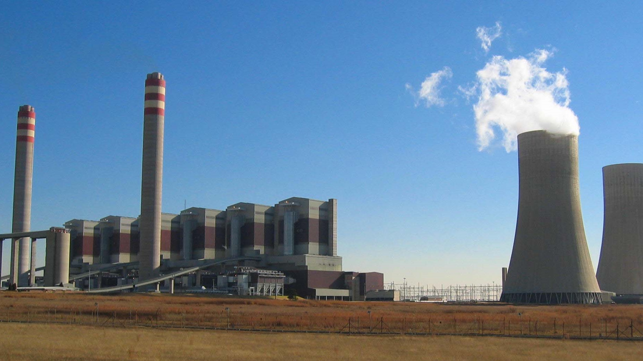
Timeline – Weekly Milestones
Week of 20th Sept
Week of 27th Sept
Week of 4th Oct
Week of 11th Oct
Week of 18th Oct
Collect & process data – Public disclosures
Oral progress report, Ethics application
Begin creating ACTMM
ACTMM prototype
Preliminary results
Ethics approval (Approx. 5th–7th October)
Seminar (Due 8th October)
Interviews ACT, Advisian
Writing final report
Submit final report (Due 25th October)
Final results
ACTMM finalised
Abstract (Due 1st October)

Slide 7
Current Progress
Upcoming Work
Data collection – Public disclosures
Begun adapting ACTGM decarbonisation assessment tool
Advisian & ACTi have agreed to a future interview
Whilst waiting for ethics approval…
Complete ACTMM prototype
Preliminary results using data from public disclosures

Slide 8
Challenges
Ethics approval time uncertainty Response:
Preliminary results using publicly available data
Disclosing Client name Response:
Alternatively, focus on Consultant’s “NZE Roadmap Project” and keep the Client name redacted

